Slide 1
RISK vs. REWARD
How much would you bet you’re right?
A real-time trivia game where contestants wager their confidence on every answer, shaping how much they can win – or lose – throughout the game.
Format: 1-Hour Studio Game Show Players: Solo or Couples Structure: 12 Questions per Game Episodes: 2 Games per Episode Prize Range: $0.01 to $1,000,000
THE HOOK RISK vs. REWARD transforms trivia into a real-time decision system where confidence directly controls financial outcome.
As contestants adjust a live slider before each answer, they instantly see: • what they will win if correct • what they will lose if wrong • and how much they can still win going forward
Every decision permanently shapes the path to the final prize.
NOT A QUIZ SHOW. A DECISION SYSTEM.
Created by: Eddie Lawhorn 📧 eddielawhorn@bellsouth.com | 📞 (256) 975-2238 | 🌐 eddielawhorn.com
A working prototype demonstrates the real-time risk system and evolving earning trajectory at: https://eddielawhorn.com/risk-vs-reward/game

Slide 2
A deceptively easy question… worth a million dollars. Would you know it – or how much would you RISK?
Concept Overview
What is RISK vs. REWARD?
A high-stakes trivia game show where contestants control their fate using a dynamic RISK/REWARD slider.
Each of 12 questions lets them choose a category and set how much they’re willing to risk – and how much they stand to gain.
The more they risk, the more they can win… or lose.
At maximum risk, a perfect game earns $1,000,000. Miss every question? You still walk away with $0.01.

Slide 3
What Makes It Unique
Slider Mechanic – Contestants control their own stakes
Psychological Pressure – Strategy meets stress
No Walk-Away Option – Every decision counts
Compounding Rewards – Like interest, the stakes grow
Play-Along Potential – Viewers naturally test their own confidence on every question
Couples Mode – Adds emotional tension and teamwork
Knowledge and confidence become two separate skills.

Slide 4
How It Works
12-question studio game
Contestants choose a category each round
Question and answers appear first
Contestants select an answer
Then set confidence using a real-time slider
Bank and how much they can win update visibly
Lock in → instant reveal
One “Do Over” lifeline (Questions 1-6 only) – cancels a disastrous moment and replaces the question
Every decision visibly changes the contestant’s financial trajectory.
Click here to watch the video.
See the stakes unfold.
How would you play?

Slide 5
The Stakes
RISK and REWARD values compound over time
Early rounds build slowly
Final rounds can spike dramatically
One wrong answer can drastically reduce what you can still win
Strategic confidence management is key to maximizing winnings
Each step intensifies the risk. The million isn’t just a number – it’s the final leap that separates legends from hesitation.

Slide 6
Tone & Host
The host is the audience’s guide through risk – sharp, quick-witted, and emotionally attuned
They translate confidence into consequences, narrating rising stakes with humor, empathy, and precision.
Keeps the energy high and the gameplay fun
“You start the game with money in the bank. The producer says that’s for putting up with me.” “I wouldn’t worry about the money – I get paid the same no matter how you do.”

Slide 7
Audience & Appeal
Ages 18-49, broad gender appeal
Trivia fans, strategy gamers, risk-takers, and casual viewers
Viewers don’t just watch the game – they play along
Every question sparks debate: “What would you have done?”
The show naturally generates social buzz, strategy discussion, and repeat viewing

Slide 8
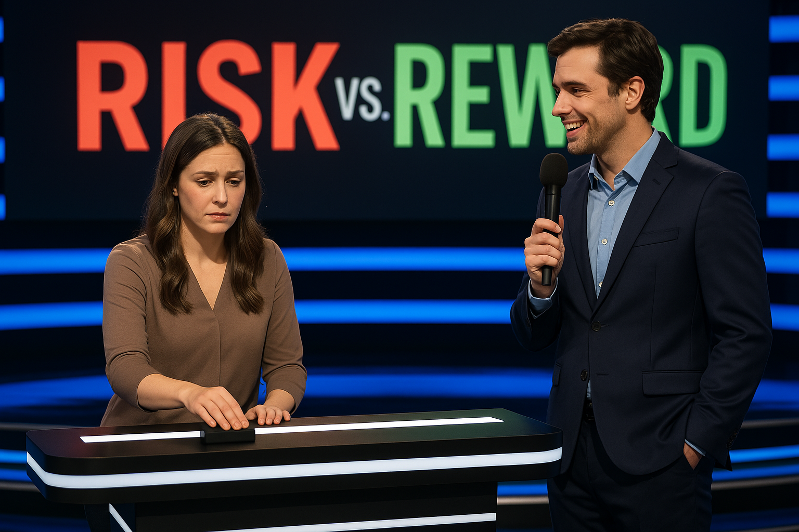
Set & Visual Style
Sleek, modern set with a central slider control
Real-time graphics show RISK, REWARD, and trajectory
Countdown timer and dramatic lighting build tension
Designed for high visual impact and audience immersion

Slide 9
Spin-Off Potential
Couples Edition – Shared decision-making and drama
High Stakes Week – Bigger prizes, tougher questions
International format potential with localized trivia
Celebrity Edition – Famous players risk winnings for charity

Slide 10
RISK vs. REWARD
It’s more than a trivia game. It’s a test of nerve, knowledge, and how far you’re willing to go.
A working prototype demonstrates the real-time risk system and evolving earning trajectory at: https://eddielawhorn.com/risk-vs-reward/game.
Created by: Eddie Lawhorn 📧 eddielawhorn@bellsouth.com | 📞 (256) 975-2238 | 🌐 eddielawhorn.com

